Slide 1
Paper Review An Empirical Evaluation of Thompson Sampling
Olivier Chapelle, Lihong Li
NIPS 2011
Citation=492

Slide 2
Issue
To solve exploration / exploitation or bandit problem
Major Algorithm
UCB
Gittins
Thompson Sampling

Slide 3
UCB
Strong theoretical guarantees on the regret
But…
Gittins
Bayes-optimal approach
TS
Idea
To randomly draw each arm according to its probability of being optimal
(Not full Bayes, namely simple)
Lack of theoretical analysis

Slide 4
In this paper….
Algorithm description ➔ Comparison between algorithms ➔ Conclusion

Slide 5
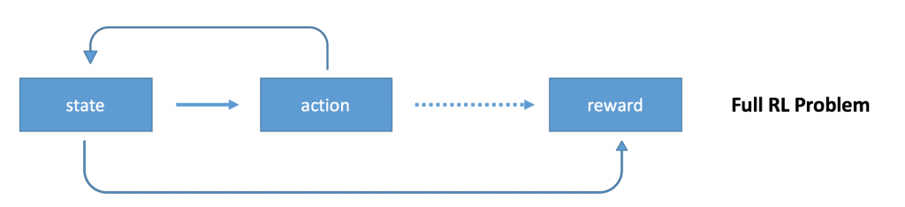
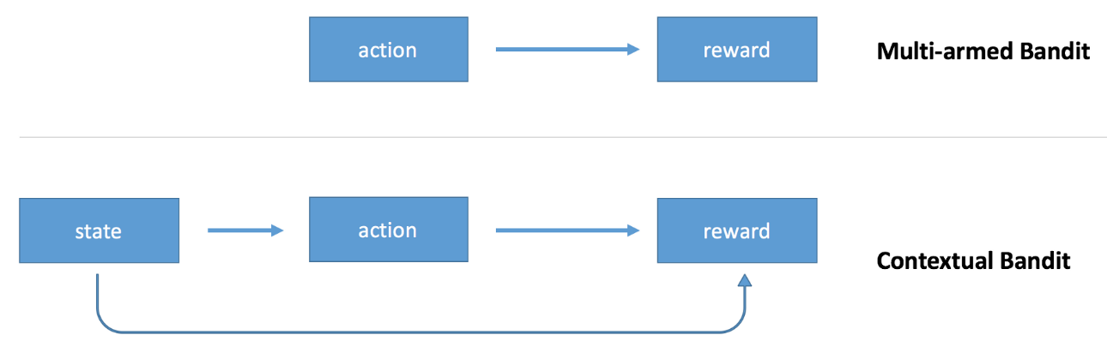
Before begin…
Do you know the difference between Multi armed bandit and reinforcement learning?
Have you heard about the contextual bandit?
MAB deals with only action to get reward, but there is more things to think, ‘state’, in the contextual Bandit problem. It is different from reinforcement learning.
Source from http://pavel.surmenok.com/2017/08/26/contextual-bandits-and-reinforcement-learning/

Slide 6
Experiment data set : display advertisement selection, news article recommendation
Problem Setting
Contextual Bandit
Thompson Sampling

Slide 7
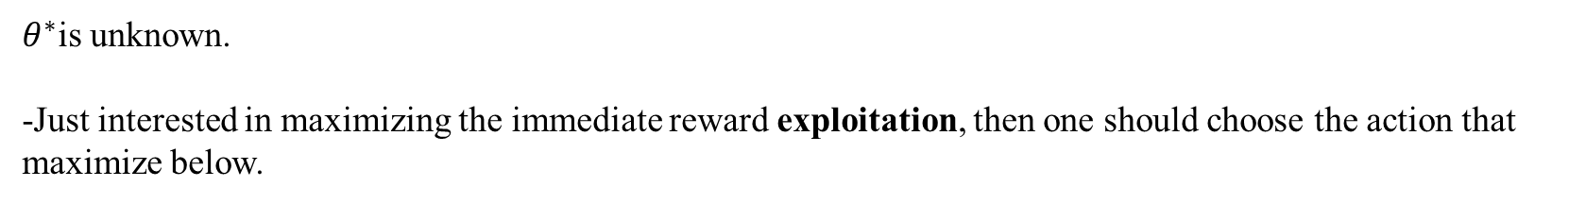
$θ^{∗}$is unknown.
-Just interested in maximizing the immediate reward exploitation, then one should choose the action that maximize below.
-the probability matching heuristic consists in randomly selecting an action a according to its probability of being optimal
Not computed explicitly

Slide 8
The left below figure is from “finite time analysis of the mab problem”
Each action corresponds to the choice of an arm

Slide 9
Simulation
Reward Probability
Best arm = 0.5
K-1 other arms = 0.5 - epsilon
Analysis
The result include already some prior mismatch because the Beta prior with parameters (1,1) has a large variance while the true probabilities were selected to be close to 0.5. But…
Always better than UCB.

Slide 10

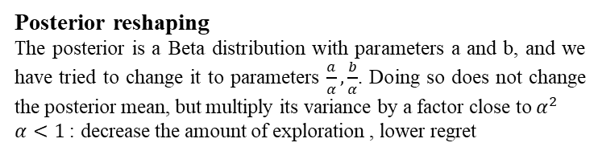
Right: distribution of the regret at T=${10}^{7}$
Posterior reshaping
The posterior is a Beta distribution with parameters a and b, and we have tried to change it to parameters $\frac{a}{α},\frac{b}{α}$. Doing so does not change the posterior mean, but multiply its variance by a factor close to $α^{2}$
$α<1$ : decrease the amount of exploration , lower regret
Impact of delay
In a real world, the feedback is typically not processed immediately because of various runtime constraints. They try to quantify the impact of this delay by doing some simulations that mimic the problem of news articles recommendation.
It appears that Thompson sampling is more robust than UCB when the delay is long.
I think this difference comes TS’s randomizing over actions (contrast to UCB – deterministic)

Slide 11
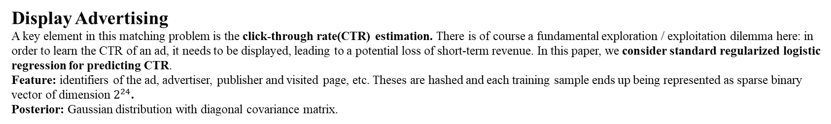
Display Advertising
A key element in this matching problem is the click-through rate(CTR) estimation. There is of course a fundamental exploration / exploitation dilemma here: in order to learn the CTR of an ad, it needs to be displayed, leading to a potential loss of short-term revenue. In this paper, we consider standard regularized logistic regression for predicting CTR.
Feature: identifiers of the ad, advertiser, publisher and visited page, etc. Theses are hashed and each training sample ends up being represented as sparse binary vector of dimension $2^{24}$.
Posterior: Gaussian distribution with diagonal covariance matrix.
The clicks are artificially generated with probability below.
Method
Thompson sampling with Gaussian posterior approximation
LinUCB
Exploit-only Select the ad with the hightest mean
Random Select the ad uniformly at random.
Epsilon greedy with epsilon probability, select a random ad; other wise, select the one with the highest mean
The input feature vectors x are as in the real world setting, but the clicks are artificially generated with probability.

Slide 13
News Article Recommendation

Slide 14
Conclusion
Thompson sampling is a very effective heuristic for addressing the exploration / exploitation trade-off.
It does not have any parameter to tune, but their results show that tweaking the posterior to reduce exploration can be beneficial.
Since it is a randomized algorithm, it is robust in the case of delayed feedback.

